Slide 1
Unit 4-2 PROVING TRIANGLES CONGRUENT: SSS & SAS
PLANE Geometry

Slide 2
Side-Side-Side (SSS) Congruence:
If Three Sides of One Triangle Are Congruent to Three Sides of a Second Triangle, then the Triangles are Congruent
$If \overline{AB}≅\overline{XY},\overline{BC}≅\overline{YZ}, and \overline{AC}≅\overline{XZ}, then ∆ABC≅∆XYZ$.
$$B$$
$$Y$$
$$A$$
$$C$$
$$Z$$
$$X$$

Slide 3
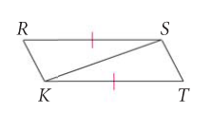
Example 1:
What Information is Missing to Prove the Triangles are Congruent using the SSS Postulate.

Slide 4
Example 2:
Write a Two-Column Proof.
Given: $\overline{AD}≅\overline{BD}, \overline{AC}≅\overline{BC}$
Prove: $∆ADC≅∆BDC$
$$C$$
STATEMENTS | REASONS
$$A$$
$$B$$
$$D$$

Slide 5
Included:
The Word Included is Used Frequently when Referring to the Angles and the Sides of a Triangle.
$$B$$
$$\overline{AB} is included$$
$$between ∠A and ∠B.$$
$$∠A is included$$
$$between \overline{AC} and \overline{AB}.$$
$$A$$
$$C$$

Slide 6
Side-Angle-Side (SAS) Congruence:
If Two Sides and the Included Angle of One Triangle are Congruent to Two Sides and the Included Angle of a Second Triangle, then the Triangles are Congruent.
$If \overline{AB}≅\overline{XY},∠A≅∠X, and \overline{AC}≅\overline{XZ}, then ∆ABC≅∆XYZ$.
$$B$$
$$Y$$
$$A$$
$$C$$
$$Z$$
$$X$$

Slide 7
Example 3:
What Information is Missing to Prove the Triangles are Congruent using the SAS Postulate.
$$J$$
$$K$$
$$L$$
$$M$$
$$P$$

Slide 8
Example 4:
Write a Two-Column Proof.
Given: $L is the Midpoint of \overline{JP} and \overline{MK}$
Prove: $∆LMP≅∆LKJ$
$$J$$
$$K$$
STATEMENTS | REASONS
$$L$$
$$M$$
$$P$$

Slide 9
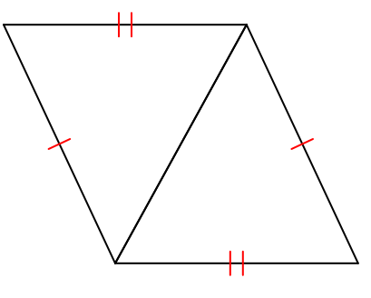
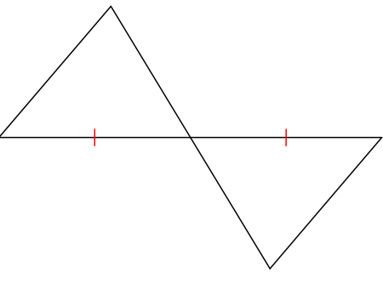
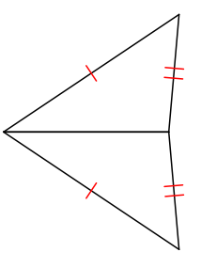
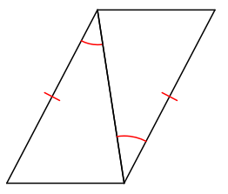
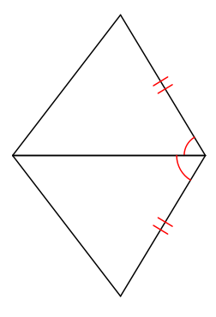
Example 5:
SSS, SAS, or Not Possible

